Slide 1

TEXT SUMMARIZATION USING NLP
TEAM MEMBERS:
Atharva Atre
Mark Trovinger
Navyaprabha Rajappa

Slide 2
AGENDA
Introduction
Problem
Motivation
Types of Text Summarization
Dataset
Methodologies
Metrics
Experiments
Results
Analysis
Future work

Slide 3
introduction
Text summarization is the process of condensing a large amount of text into a shorter version that includes only the most important information.
Summarization can help individuals and businesses save time and improve productivity, as they can quickly get an overview of the key ideas and insights without having to read through the entire document.
The process of text summarization can be automated using NLP techniques, which makes it more efficient and accurate than manual summarization.

Slide 4

Problem
With the growth of digital content, there is a vast amount of information available in various forms, such as news articles, research papers, articles, social media, and business reports. It is estimated that around 2.5 quintillion bytes of data are produced daily (source: IBM).
Due to this huge amount of data, it is often difficult and time-consuming for individuals and businesses to find relevant information and extract insights from it.

Slide 5
Motivation
The motivation behind text summarization using NLP is to automatically generate a concise and accurate summary of a given text, while preserving its most important information.
The aim is to assist humans in processing and understanding large volumes of text by condensing it into a shorter, more easily digestible format. Text summarization can be particularly useful in situations where the time or attention span of the reader is limited, or where large volumes of text need to be processed quickly.
Additionally, it can help automate some of the tasks that are traditionally performed by human editors or analysts, making the process more efficient and cost-effective. Ultimately, the motivation behind text summarization is to help people make better use of the vast amounts of information that are available in written form, by distilling it into its most important components.

Slide 6
TYPEs of TEXT SUMMARIZATION
Extractive summarization involves selecting and combining existing sentences from the original text to create a summary. This approach is simpler and more straightforward but may result in a summary that lacks coherence and context.
Abstractive summarization, on the other hand, involves generating new sentences that capture the essence of the original text. This approach requires more advanced NLP techniques such as natural language generation and deep learning but can produce summaries that are more coherent and contextually accurate.

Slide 7
How Text SUmmarization works
Fort Wayne lies in the humid continental climate zone (Köppen: Dfa), experiencing four distinct seasons.^{[76]} The city is located in USDA hardiness zones 5b and 6a.^{[77]} Typically, summers are hot, humid, and wet. Winters are generally cold with moderate snowfall. The average annual precipitation is 38.34 in (974 mm), recorded at Fort Wayne International Airport. During the winter season, snowfall accumulation averages 33.5 in (85 cm) per year. Lake-effect snow is not uncommon to the region, but usually appears in the form of light snow flurries.
The National Weather Service reports the highest recorded temperature in the city at 106 °F (41 °C), most recently on June 28, 2012, and the lowest recorded temperature at −24 °F (−31 °C) on January 12, 1918.^{[78]} The wettest month on record was June 2015, with 11.98 in (304 mm) of precipitation.^{[79]} The greatest 24-hour rainfall was 4.93 in (125 mm) on August 1, 1926. The snowiest month on record was January 2014, with 30.3 in (77 cm) of snowfall.^{[80]} The greatest calendar-day snowfall was 18.0 in (46 cm) on February 28, 1900.^{[81]}
Severe weather is not uncommon, particularly in the spring and summer months; the city experiences an average of 39 thunderstorm days and about 10 severe weather days annually.^{[82]} An F2 tornado struck northern Fort Wayne on May 26, 2001, injuring three and causing damage along the Coliseum Boulevard corridor and a subdivision.^{[83]} Fort Wayne experienced 91 mph (146 km/h) wind gusts in the June 2012 North American derecho, knocking out power to 78,000, uprooting approximately 500 trees,^{[84]} and costing $2.5 million
Fort Waune is located in the humid continental climate zone. The average annual rainfall is 38. 34 in ( 974 mm ) during the winter season, snowfall accumulation averages 33. 5 inches per year. the highest recorded temperature on record was June 2015, with 30. 3 in ( 125 mm ) of snowfall.

Slide 8

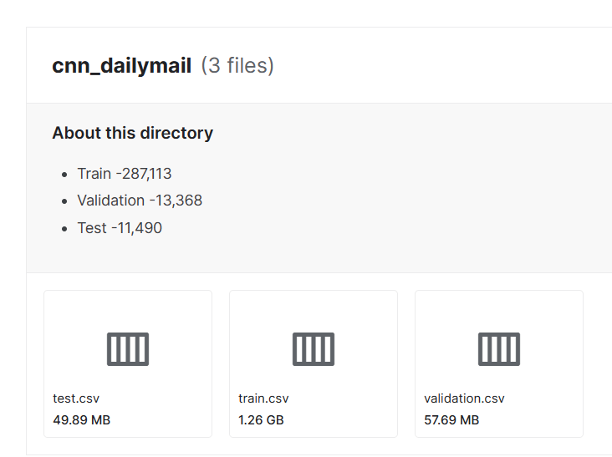
DATASET
Website:
CNN-DailyMail News Text Summarization | Kaggle
Name: CNN-DailyMail News Text Summarization

Slide 9
Methodologies
Start small
Examine results from non-NN based solutions
SpACy, HeapQ, and TextRank
Used first 20 rows of CNN/Daily Mail
Go Bigger
Transformer-based models
BERT, BART, Seq2Seq
75%+ dataset
Compute resource dependent

Slide 10
Methodology
• SpaCy: A popular Python library for natural language processing (NLP) that includes tools for text summarization.
• HeapQ: A Python library that provides an implementation of the heap queue algorithm, which can be used for extractive text summarization.
• TextRank: An unsupervised graph-based algorithm that uses PageRank to identify important sentences in a text for extractive summarization.
• BERT: A pre-trained deep learning model that can be fine-tuned for abstractive text summarization tasks.
• BART: A sequence-to-sequence model that can be fine-tuned for abstractive summarization, among other NLP tasks.
• Seq-2-Seq: A neural network architecture commonly used for machine translation, but can also be adapted for abstractive text summarization.

Slide 11
Metrics
ROUGE
Recall-Oriented Understudy for Gisting Evaluation
Pronounced “ruzs”, as in cosmetics, Moulin Rouge! and River Rouge in Michigan
ROUGE-N
Overlap of n-grams
ROUGE-L
Longest Common Subsequence
ROUGE-S
Skip-bigram

Slide 12
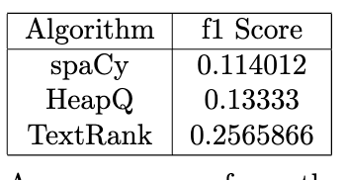
Results – Smaller models
We tested it on limited sample of dataset
We tried this experiment so that we could explore bigger models in line with our class lectures.

Slide 13
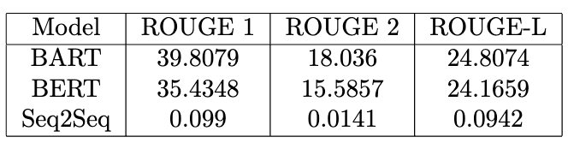
Results – larger models
Initial Experiements with pretrained models with

Slide 14
Hyper parameter optimization
BERT is a powerful pre-trained deep learning model that can be fine-tuned for abstractive text summarization.
Hyperparameters are parameters that are not learned during training, but rather set by the user beforehand. Examples include learning rate, batch size, and dropout rate.
Hyperparameter optimization involves finding the best combination of hyperparameters for a given task, in order to improve model performance.
Common techniques for hyperparameter optimization include grid search, random search, and Bayesian optimization. We used grid search
In the case of BERT for text summarization, important hyperparameters to consider include the maximum sequence length, the number of encoder layers, the learning rate, and the batch size.
Proper hyperparameter tuning can significantly improve the performance of BERT for text summarization tasks, leading to more accurate and effective summarization results.
With hyperparameter optimization, we improved our results to 18.14 from 18.06 ROGUE 2 score

Slide 15
Further work and analysis
Generalization
How well do these models perform outside of CNN/Daily Mail?
XSum Dataset
Hosted on HuggingFace
”Extreme” Summarization
Having a concise comparison report for our final report on BERT , BART and our own hyperparameter optimized BERT

Slide 16





Tools and libraries

Slide 17

THANK YOU
Any question?

